Slide 1


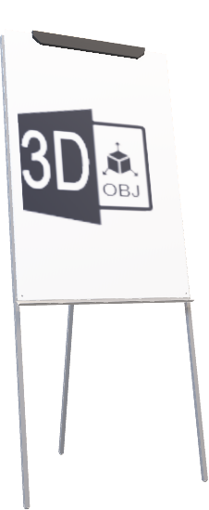
Real-world System & Interoperability Framework
Open Office 365
Live-Edit Requirements
Cloud hosted
Live Edit “Tech Notes”
Real World Simulation
2024-InteropLegos.pptx

Slide 2


HIT Interop 101 “Lego Analogy”
“Interlocking” specifications for innovative, simple, scalable products
1
2
3
+
+
=
DIY
Technology
Specification
“Interlocking” Paradigm
“Interoperability” Paradigm Alignment: Transport, Format, Machine Readable Code
Scalable Structure

Slide 3





Advanced Interoperability with regional and backbone standards definition organizations (SDO)
“Systems and Interoperability Framework” Solution Delivery Process
Lessons Learned
Evaluate
Closed
Information
Standards
Continuous Solution Delivery
Real-World Conformance Testing
Loop
Product Backlog
Development
Plan
Elaborate
Elaborate
Align
Deliver

Slide 4

Idea Parking Lot

Slide 5













Web-based stencils Emerging Health Information Standards
We sell presentation materials for ​virtual collaboration
Web Interface
P
E
N
E
O
H
A
P
S
U
S
E
Looks like we missed
the meeting on web standards
R
E
Machine
Readable
Format
Interoperable
Health
Information
Coded
Values
Global
Visual
Language
Registry
Device
Adaptive
Human
Readable
Font
Awesome
Noun
Project
Interface
Behavior
Media
Query
User
Experience
Visual
Elements
Open
Document
Format
Visual
Display
M
Scalable
Vector
Graphics
OASIS
Open
Source
D
O
User
Interface
S
High
Resolution
Templates
J
A
W
Java
Script
web
HTML
XML
I
A
Style
Sheet
Hyper
Text
Markup
Meta
Data
Screen
Reader
A
R
ADA
Was that today?
Open Information Standards
IDEA
508
WCAG
Digital
Interface
Accessible
Web
…
…
<HTML>
open
A
Rich
(asynchronous)
Internet
Applications
reusable
assets
Accessible
Interoperable
Technology
SME
>
>
Office 2013
>
>
2020 Pandemic
Services - For Every Idea LLC

